Slide 1
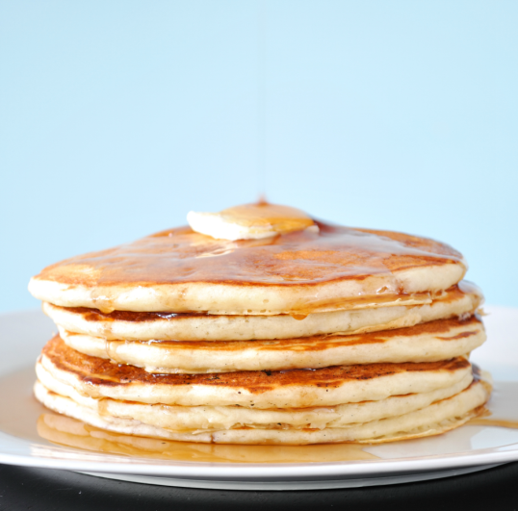
You are invited to a pancake breakfast
Sponsored by the East El Paso Rotary Club
Date: Saturday, 7 October 2016
Time: 8:00 – 10:00
Location: Applebee's on Yarbrough and I-10
Cost: $6 See any East El Paso Rotary club member for tickets,
or email eastelpasorotary@hotmail.com

